Slide 1
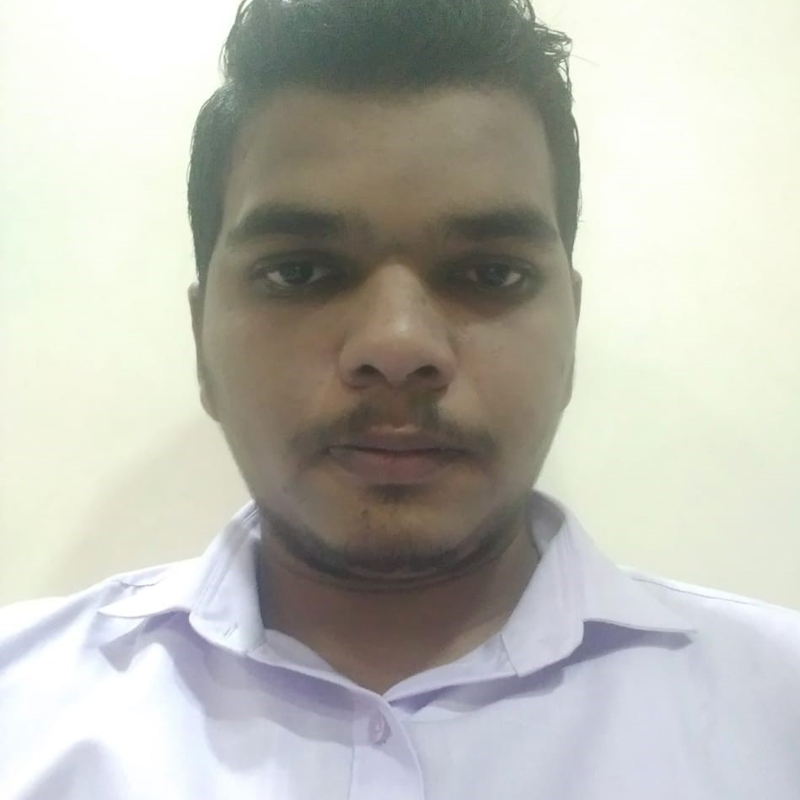


Krishna Nandlal Gupta
Analyst/Software Engineer
Bachelor of Engineering
Mechanical : 2018 - 2021
Skills
Java 8 /J2EE | Java Basics, OOPS, Collections, Arrays, Loops, Lambda Exp, Stream API, Exception Handling.
Spring core | IOC & Dependency Injection, Autowire..
Spring REST | REST controllers, Implementation of GET, POST, PUT & DELETE, Bean Validation & Exception Handling, Testing Services, Controller & Repository layer.
Spring Data JPA | Implement DAO layer using spring Data repositories, Transaction Management..
React | Components, Hooks, Event handling, Redux.
Database | MongoDB No-Sql Basics. My SQL,Postgres SQL RDBMS
UI Tech | HTML 5 & CSS 3,JavaScript, ES6 & TypeScript.
Tools | Git, Postman, Maven, Eclipse IDE
Add On skills | Communications, Team management. Peer learning.
Mumbai
krishna-nandlal.gupta@capgemini.com
+91 9702893924
A4
Full Stack Developer
Having a good knowledge on Spring core, Spring MVC , Spring boot.
Having a good knowledge in developing Web pages using HTML, CSS, JavaScript.
Having a good knowledge in creating the single page Web applications using React.
Currently improving my skills on the i-Transform platform.
Having a good knowledge on microservices.
Ready to learn the new Technologies and implement them for future knowledge improvement.
Online Railway Reservation System (Case Study)
Created online Railway Reservation System which is used by the passenger to book tickets from one station to another. With the help of various microservices we made the backend and with the react we made the frontend.
Expense Tracker (React Project)
Created an expense Tracker which keeps the track of the expense of an items on the particular date and we can also see total expense for the particular month . Also the expenses could be added and removed for the particular month.
Checkout my work on GitHub

